Slide 1
Physics
please help me
Aengus, 2024

Slide 2
Why solving relativistic equations aren’t as easy as I thought?
Physoc gave us distractions
I had to leave early

Slide 3
Aims
Solve Relativistic EoM for particles in Schwarzchild Metric described Space
This is space surrounding a non-rotating, non-charged black hole.
Attempt to model tidal stresses on objects in orbits.

Slide 4
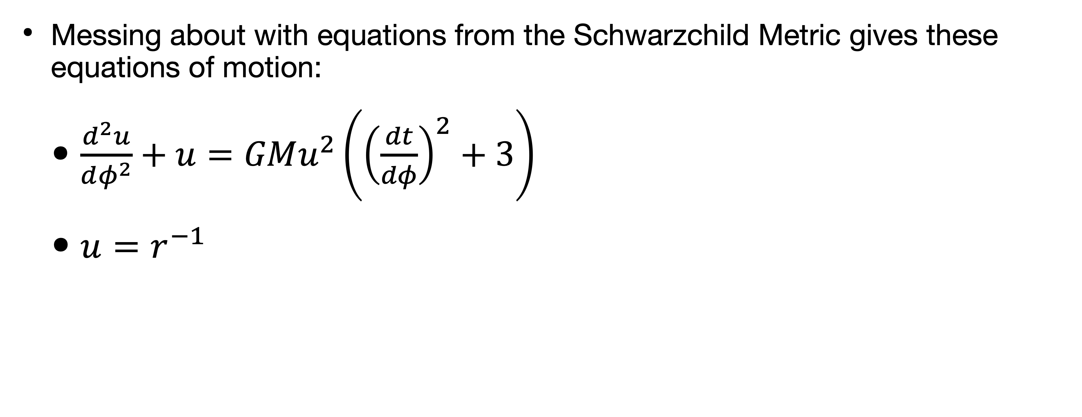
Issues
(Why you aren’t currently looking at some nice results)
Messing about with equations from the Schwarzchild Metric gives these equations of motion:
$\frac{d^{2}u}{dφ^{2}}+u=GMu^{2}\left({\left(\frac{dt}{dφ}\right)}^{2}+3\right)$
$u=r^{−1}$

Slide 5
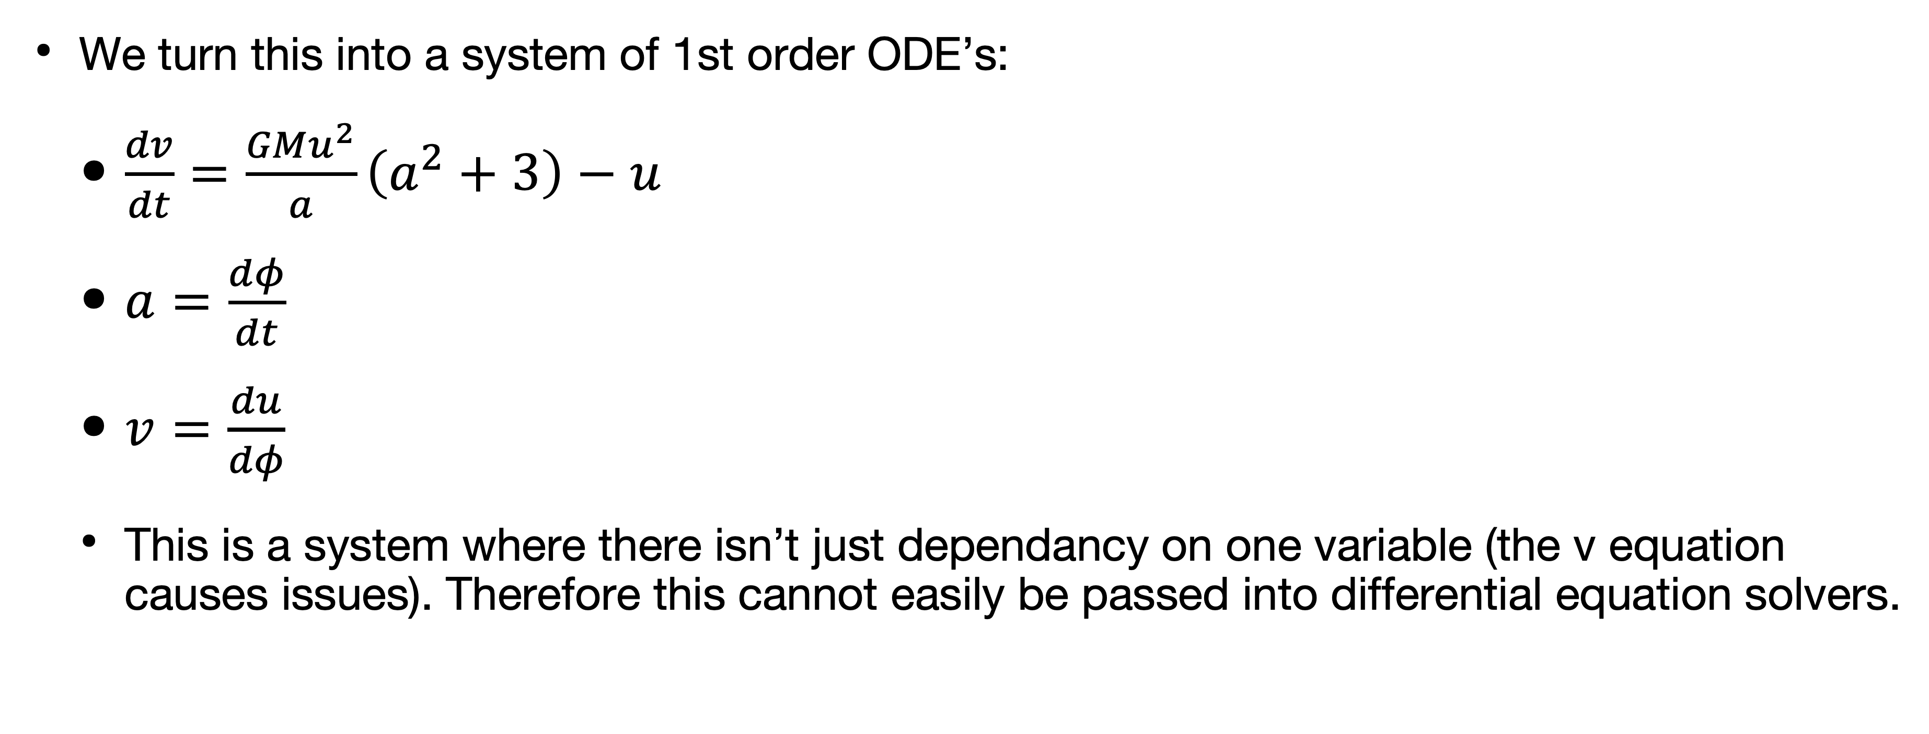
Turning this into something a computer can comprehend
Because the lord knows that I can’t
We turn this into a system of 1st order ODE’s:
$\frac{dv}{dt}=\frac{GMu^{2}}{a}\left(a^{2}+3\right)−u$
$a=\frac{dφ}{dt}$
$v=\frac{du}{dφ}$
This is a system where there isn’t just dependancy on one variable (the v equation causes issues). Therefore this cannot easily be passed into differential equation solvers.

Slide 6
What you should be looking at
Nice pretty graphs I guess?
An object orbiting a black hole as governed by the equations of motion
Object changes colours as it gets closer and experiences more tidal forces.

Slide 7
Bonus meme
What Tom did for 5 hours
I Spent 5 hours creating a Blender image of a Schwartzchild Black hole
I never used Blender before today
Here is the result:

Slide 8
